Slide 1

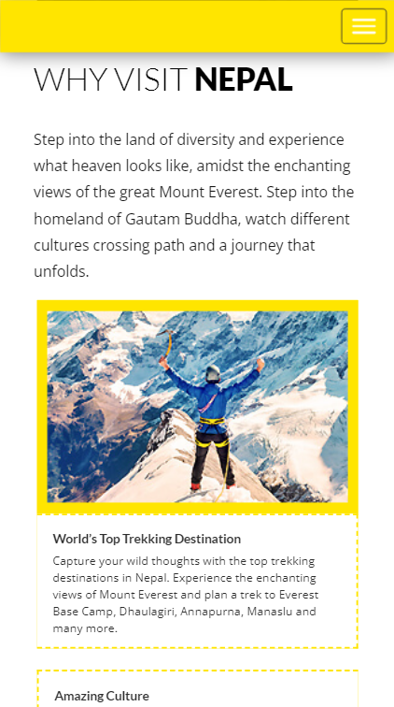


Journey with VR
Travel Share Explore

Slide 2

OBJECTIVE
Allocate the capital, for Journey Journals
Provide Information of Places, Review, Suggestions and Blog
VR experience In Room.

Slide 3
We all Have one Desire
To Travel
But the Break Is
Lack of Money

Slide 4
AS WE PROVIDE
FUND
journey Journals,
Provides Reviews, Suggestion Of places, and 360 VR Video

Slide 5
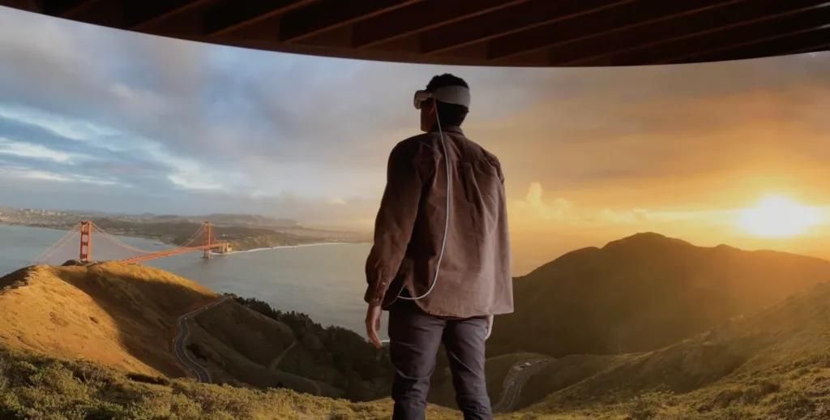
360 VR Videos Image
Are Then Given to End User

Slide 6
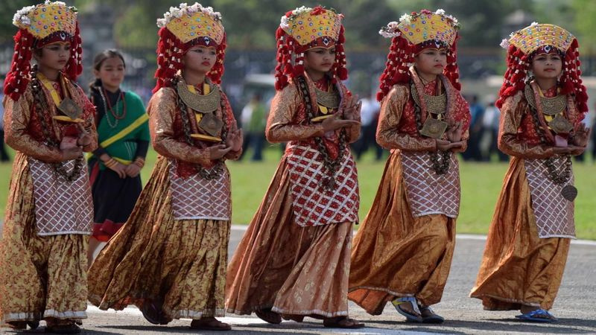

We Give
Experience
Real

Slide 7


Studio Shodwe
Home
Photo
About Us
Contact
Business
Model
VR Footage in Premium
Collaborate With Government
Highligting Other Business

Slide 8

thank
you

